Slide 1
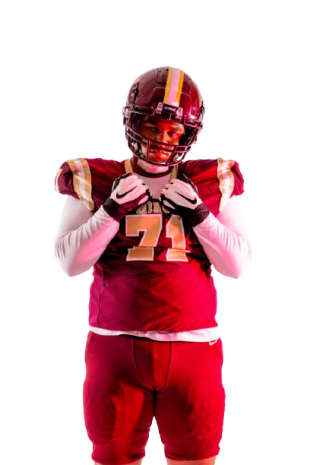

MIDWEST
ALL AMERICAN
BOWL

Slide 2
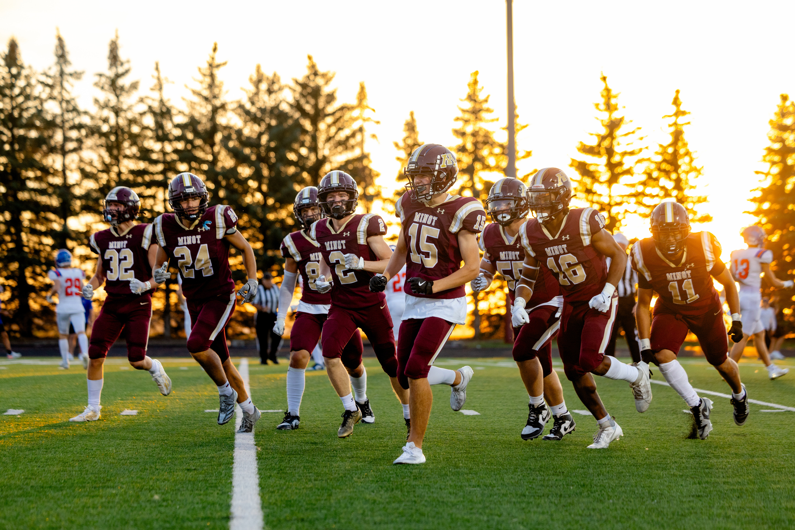
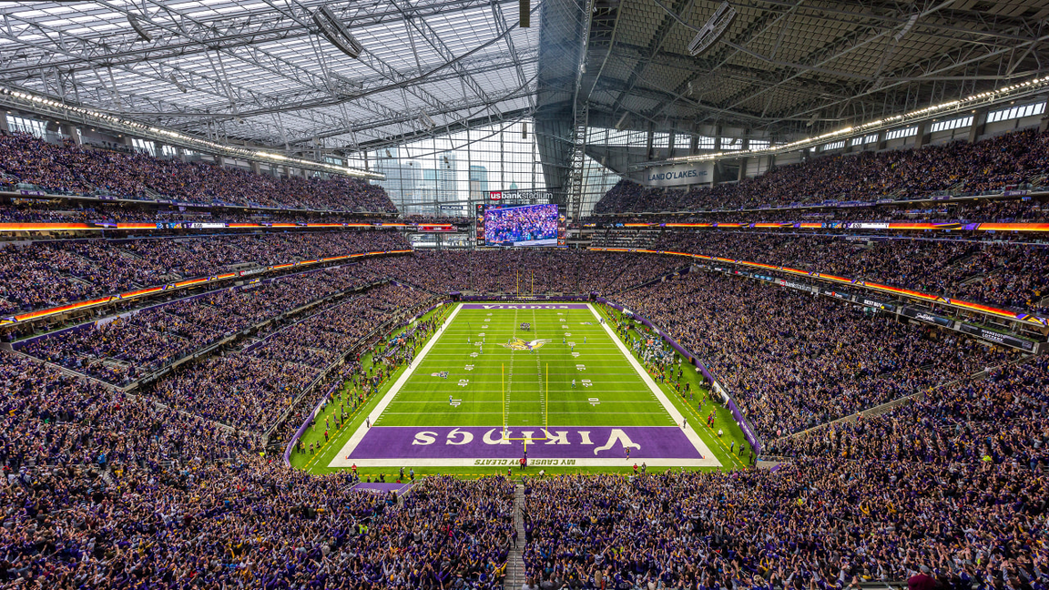
ABOUT OUR
ALL AMERICAN SHOWCASE
  The showcase will be held from June 15th-18th
  It will be held at the US Bank Stadium
  The first 2 days will be drills and learning skills from Real NFL players
  NFL Players include Justin Jefferson, Myles Garrett, Jordan Love, Saquon Barkley, and Jalen Ramsey

Slide 3
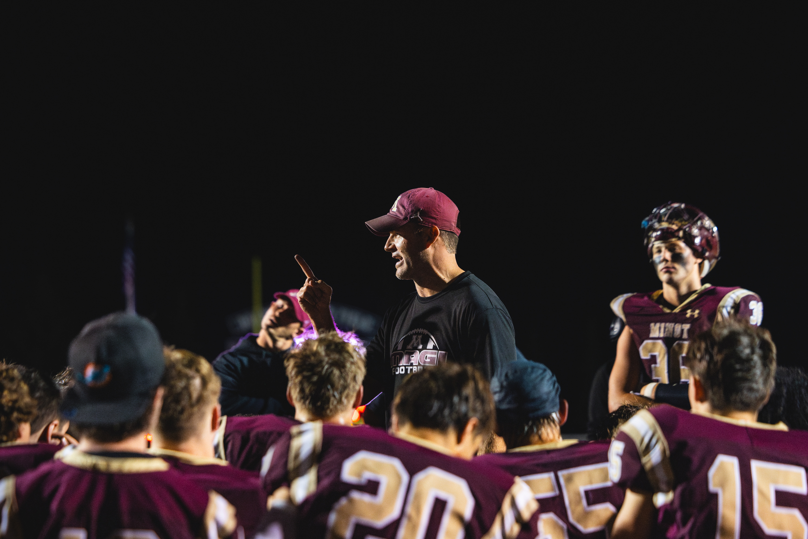
Day 3
THE GAME
On The last day (18th) we will have the all american bowl game. We have divided the teams based on North and South Midwest states. This will be a tackle game so everyone will need to bring their pads. It will be four 10 minute quarters each team will have 6 timeouts total.

Slide 4
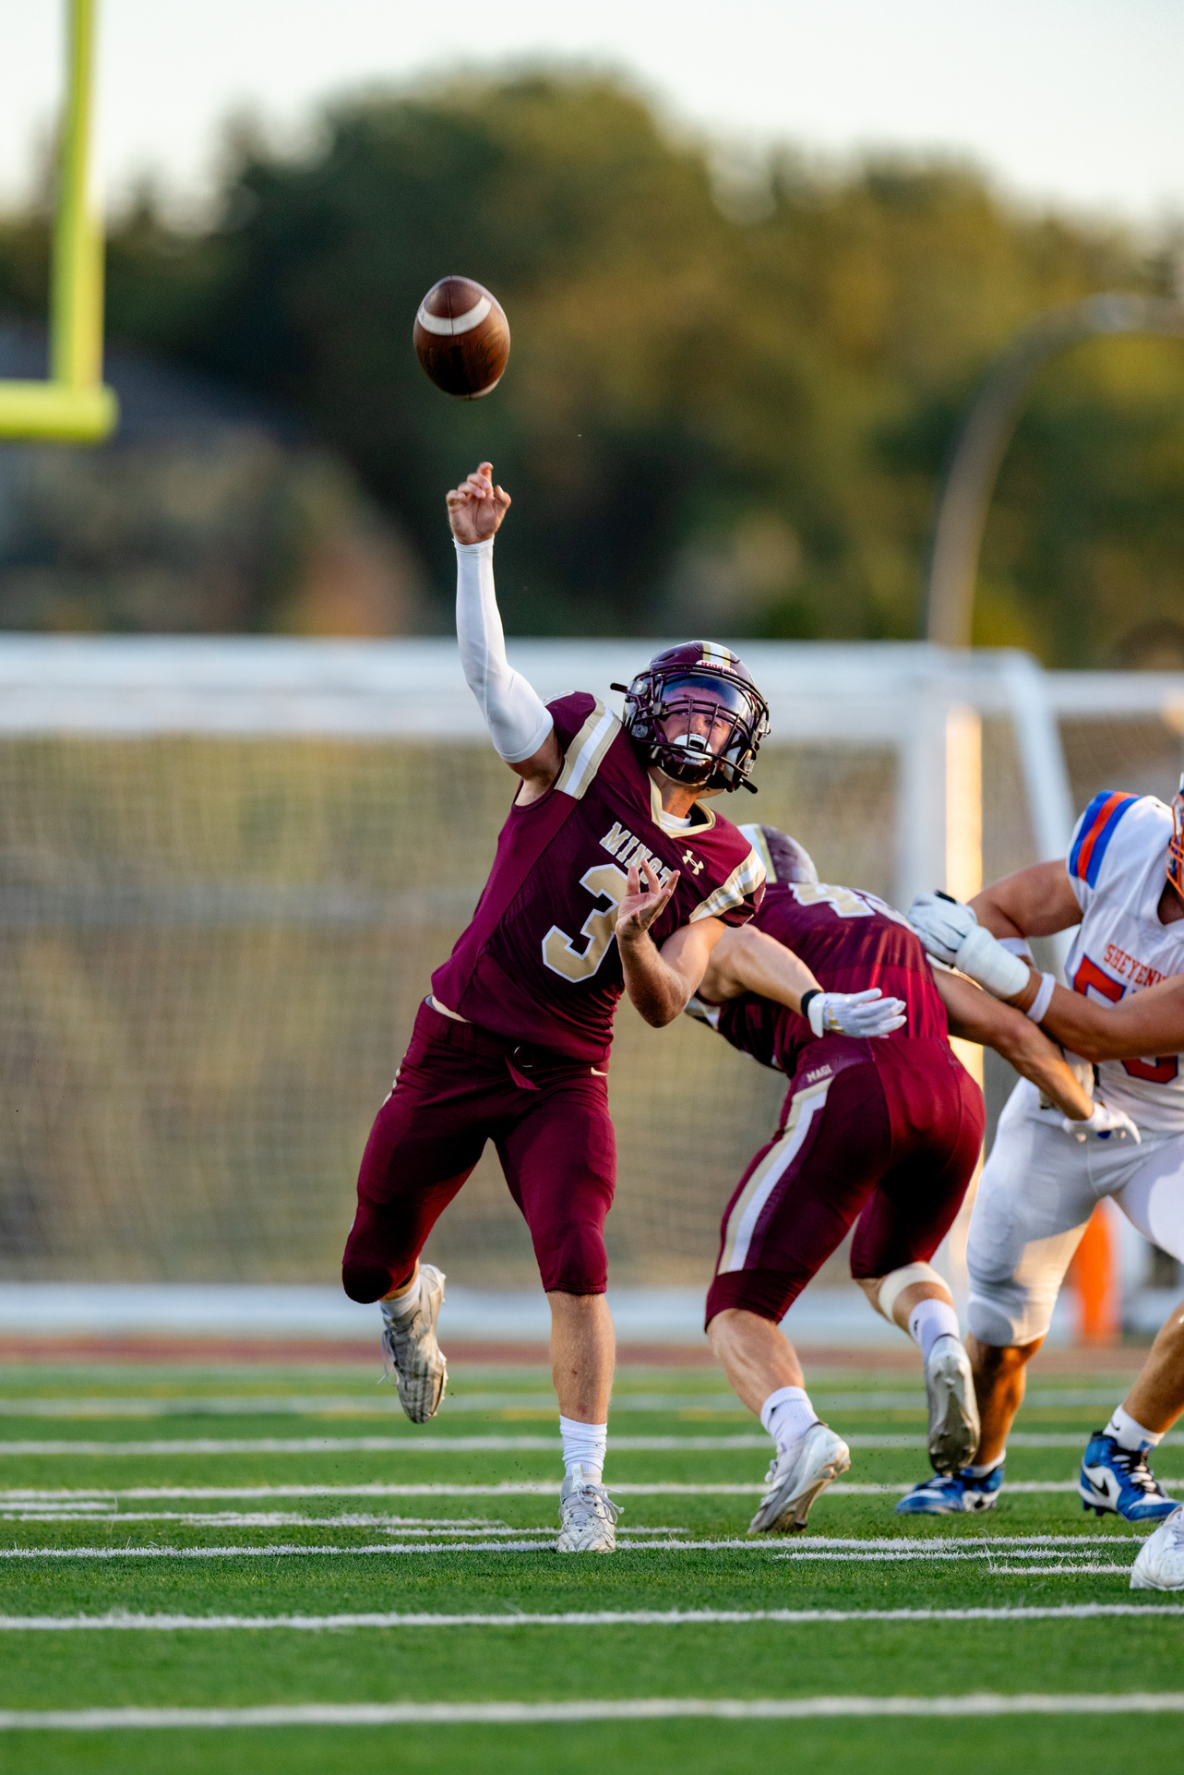
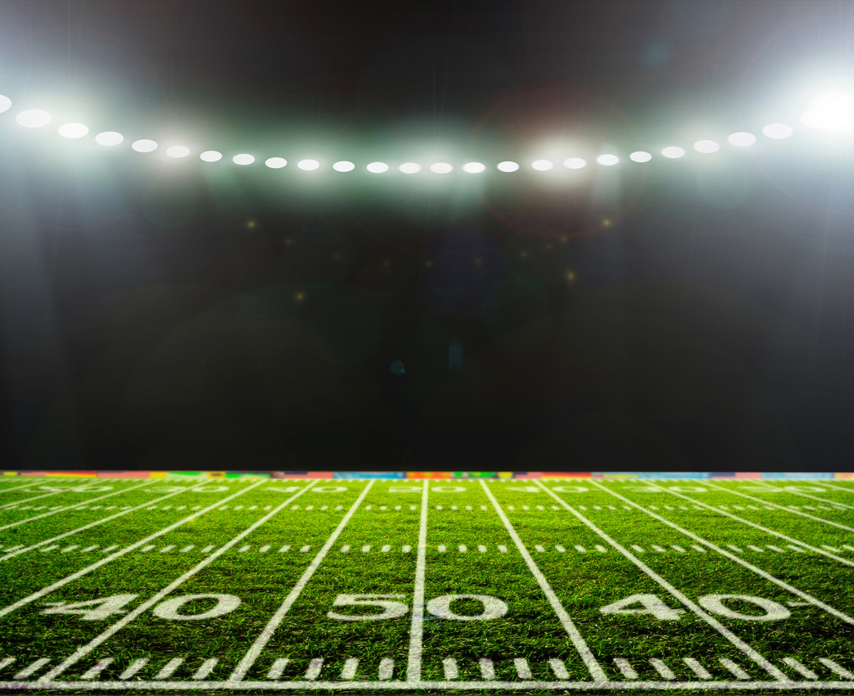
AWARD
CEREMONY
We will conclude this showcase by handing out awards to players who we thought earned them. Awards include MVP, Most Improved, Hardest Worker, Best Hands, Best Arm, and Strongest Leg.

Slide 5
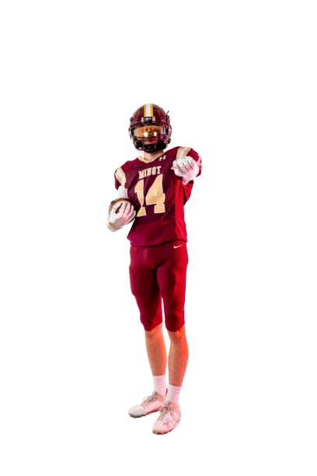
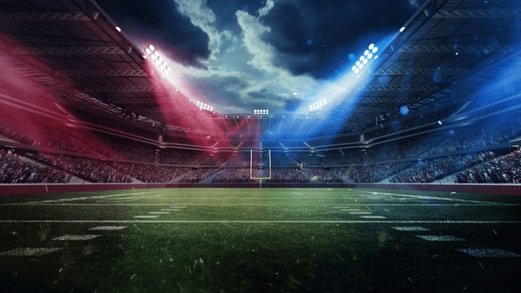
THE PRODUCT
The opportunity to improve football skills, gain professional coaching, build confidence, and experience team camaraderie in a supportive and competitive environment.

Slide 6
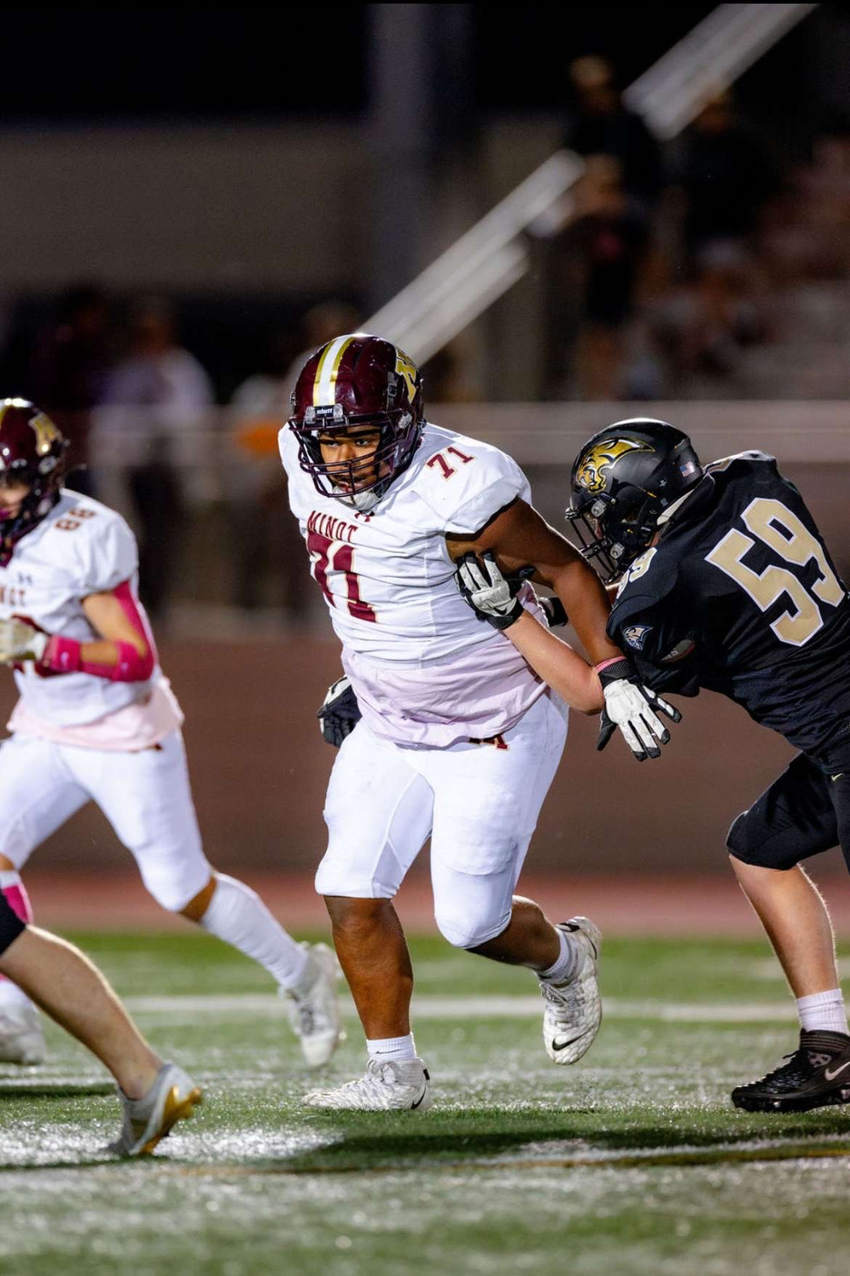
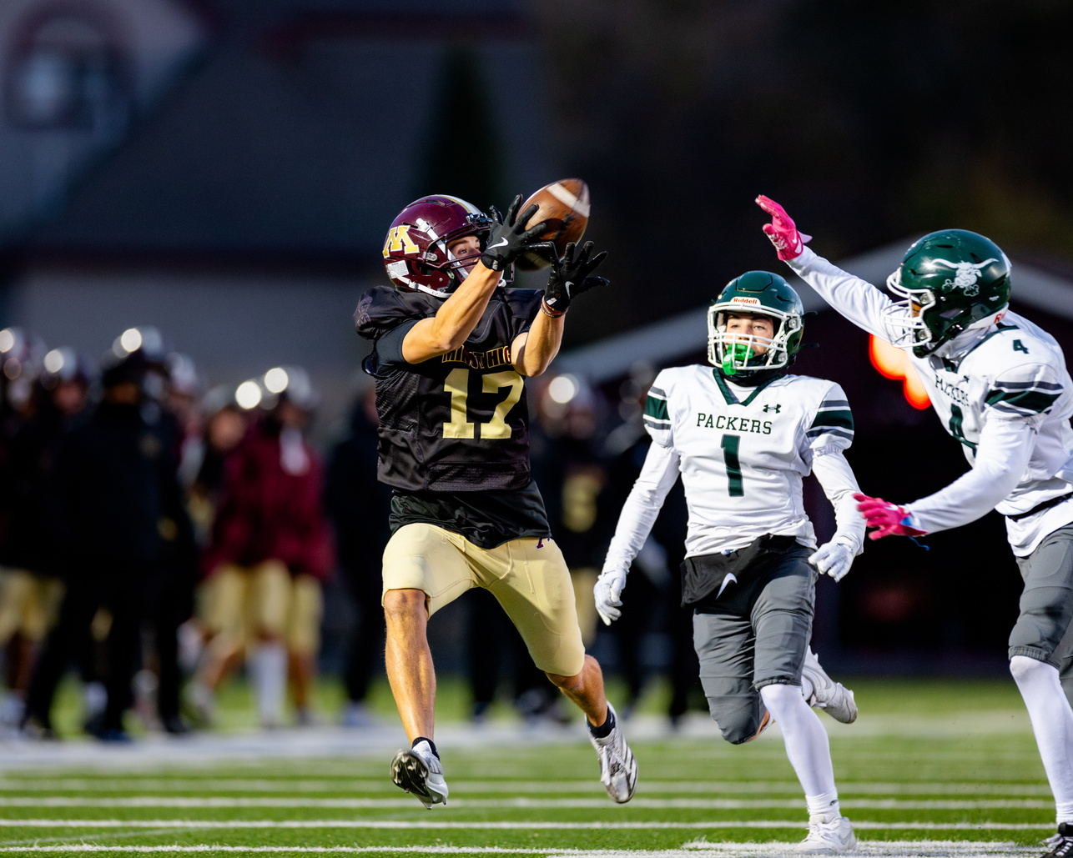
ANCILLARY
PRODUCTS
  Branded Apparel
  Personalized Video Highlights
  Training Gear
  Camp App

Slide 7
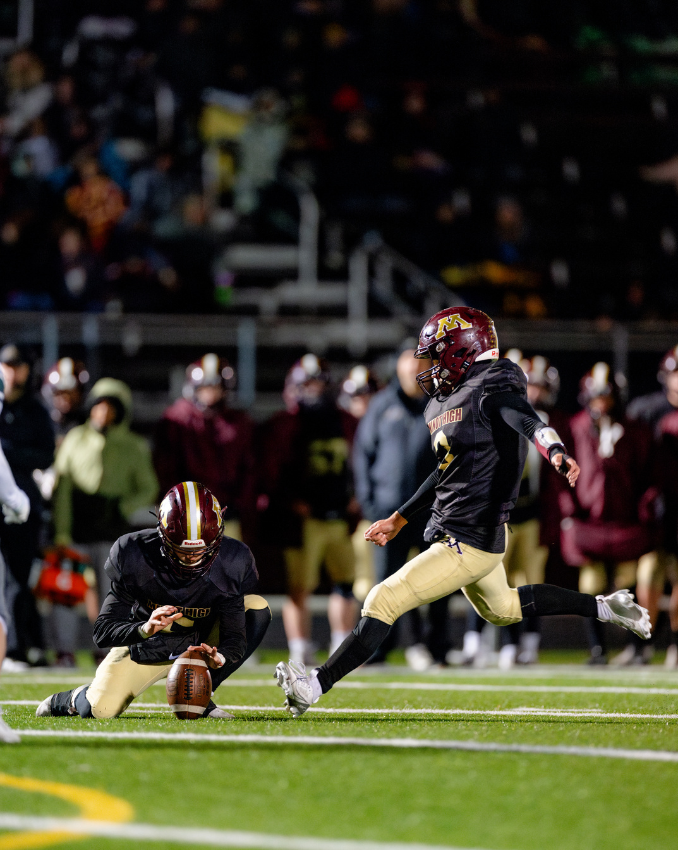
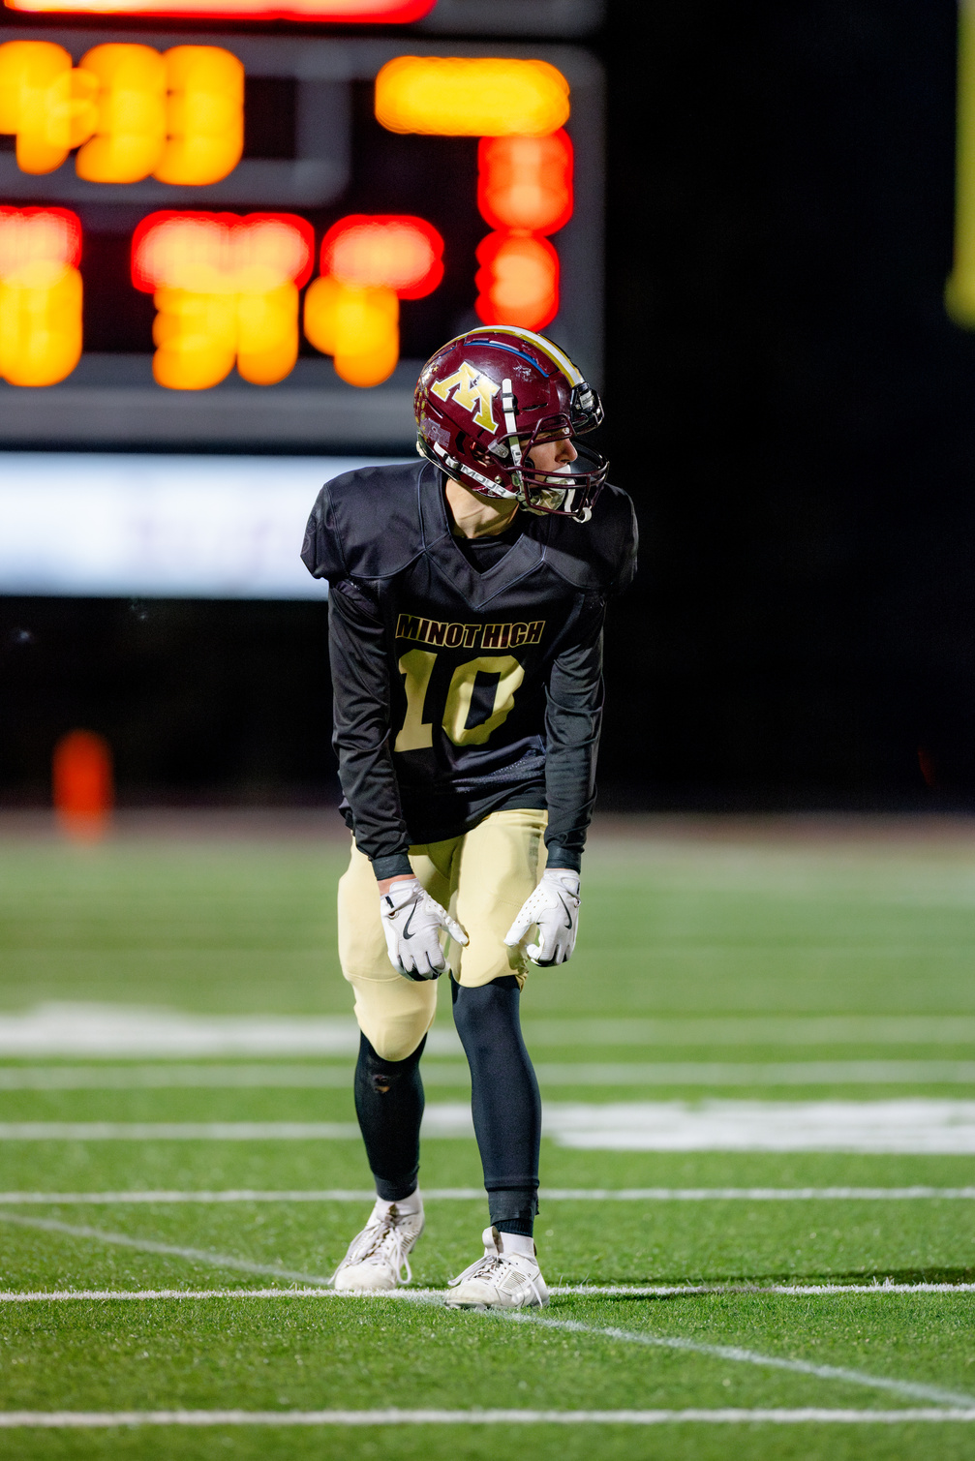
HOW TO GET TICKETS
  Offical Website
  Personal Invite from Camp Officials
  Mobile Ticketing
  PDF Tickets
  In-Person Pickup

Slide 8

REQUIREMENTS FOR GETTING INTO THE SHOWCASE
  Personal ID
  Ticket Purchase Confirmation
  Parental Consent (For Minors)
  Liability Waivers

Slide 9
TICKET
PRICING
Standard Price
VIP Package
  Price Range: $200 - $300 per participant
  This is the base price for all participants who want to attend the football camp.
  Full access to all training sessions and drills.
  Camp facilities usage (fields, locker rooms, etc.).
  Basic camp gear (T-shirt, water bottle, etc.).
  Lunch and snacks during camp hours.
  Price Range: $400 - $600
  All the benefits of the standard ticket (full access to sessions, camp gear, meals, etc.).
  Access to exclusive one-on-one coaching sessions with the head coach or special guest coaches.
  VIP seating at camp showcases or final-day scrimmages.
  Exclusive VIP swag (branded sports bag, personalized jersey, etc.).
  Priority registration for next year’s camp.

Slide 10
TICKET
PRICING
Group or Tem Package
Family Member Package
  Price Range: $150 per participant (minimum 5 participants)
  Groups or teams that register together receive a discounted rate. This package encourages coaches, school teams, or friends to attend together. The price applies when at least 5 individuals from the same group sign up at once.
  Group pricing encourages bulk registrations, helping the camp increase participant numbers. It also creates a fun, team-oriented environment where participants can bond and train together.
  Price Range: $500 - $800 for 3 participants
  A family package where families with multiple children can register for the camp at a discounted rate. For example, 3 family members attending the camp would pay a reduced combined rate.
  All the standard camp offerings for each participant.
  Additional discounts on merchandise for family members.

Slide 11
SPONSORS
Nike
  Brand Alignment: Nike’s focus on sports performance and youth development perfectly aligns with the camp’s mission to nurture young athletes and help them reach their full potential.
  Global Exposure & Prestige: As a globally recognized brand, Nike’s involvement would enhance the camp’s credibility, attract more participants, and provide significant marketing reach.
  Access to High-Quality Gear & Resources: Nike can supply top-tier equipment and apparel, enriching the camp experience while showcasing their products in real-world athletic settings.

Slide 12
SPONSORS
Schutt
  Brand Alignment: Schutt is a leading manufacturer of football helmets and equipment, making them the perfect fit to provide high-quality gear for the camp, ensuring safety and performance for all participants.
  Product Integration: Schutt’s helmets, pads, and other gear would be featured throughout the camp, allowing participants to experience top-of-the-line equipment during training, which enhances the camp’s professional reputation.
  Exposure to Target Audience: Schutt's involvement allows them to showcase their products to a key demographic—youth athletes and their families—who are likely to need high-performance equipment for their teams or personal use.

Slide 13
SPONSORS
Applebees
  Community Support: Applebee's provides meals and snacks for participants, fostering a supportive and community-driven atmosphere during the camp.
  Local Exposure: With their logo on event signage and promotional materials, Applebee's gains visibility among local athletes and families, increasing brand awareness.
  Mutual Benefits: Applebee's can offer special discounts or promotions to camp attendees, encouraging customer visits while supporting the camp experience with quality food options.

Slide 14
Five Forms of Media
  Social Media (Facebook, Instagram, Twitter)
  Great for reaching parents and athletes with event updates, photos, and promotions.
  Promotes engagement and easy sharing.
  Start: 3-4 months before the event.
2. Website & Email Marketing
  Central hub for registration and info; email keeps participants updated and reminded.
  Directly reaches interested families and athletes.
  Start: 3-4 months before the event.

Slide 15
Five Forms of Media
3. Local Radio & Community Partnerships
  Targets local families through trusted stations and organizations.
  Builds community support and awareness.
  Start: 2-3 months before the event.
4. Flyers, Posters, & Local Print Media
  Grabs attention in schools, gyms, and community spots.
  Reaches those less active online.
  Start: 2 months before the event.

Slide 16
Five Forms of Media
5. Online Ads (Google & Facebook Ads)
  Targets parents actively searching for camps.
  Drives traffic to the registration page.
  Start: 1-2 months before the event.

Slide 17
Timeline of Promotions
  3-4 months before the event: Begin social media campaigns, website, and email marketing to build awareness and start early registration.
  2-3 months before the event: Ramp up local radio promotions and community partnerships, while distributing flyers, posters, and print ads in local spaces.
  1-2 months before the event: Launch online ads (Google, Facebook) and intensify social media activity to push last-minute registrations and highlight special offers.

Slide 18
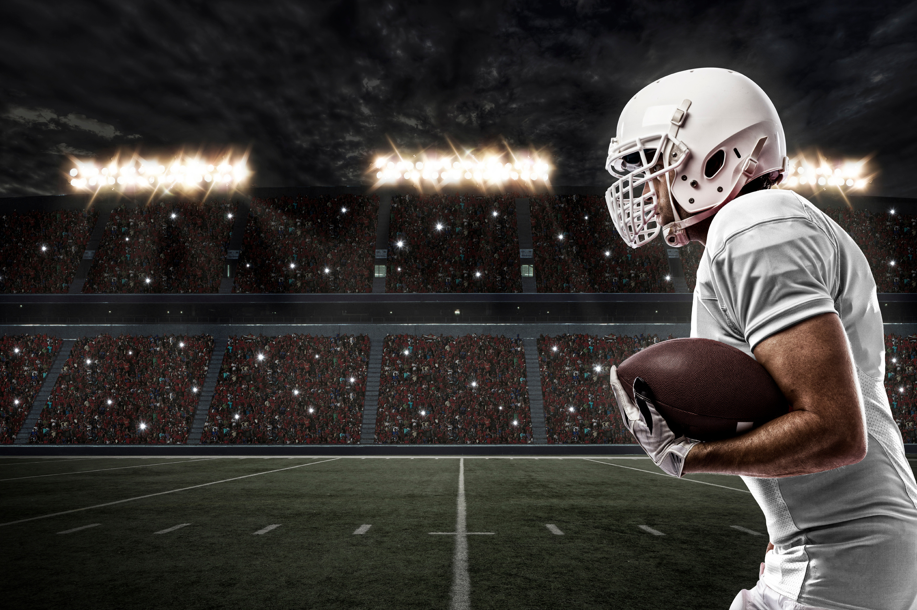
THANK
YOU FOR
LISTENING

